Slide 1
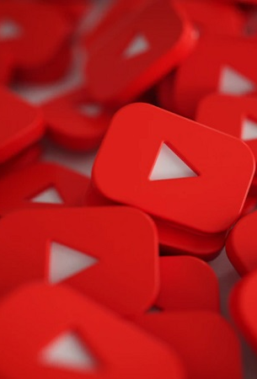
Desing Applications Project: Correlations Between Labels and Titles of YouTube Videos
By Rotinda Öner
YILDIZ TECHNICAL UNIVERSITY
FACULTY OF CHEMISTRY-METALLURGICAL
DEPARTMENT OF MATHEMATICAL ENGINEERING
Advisor: Prof. Dr. Fatma Aydın Akgün

Slide 2
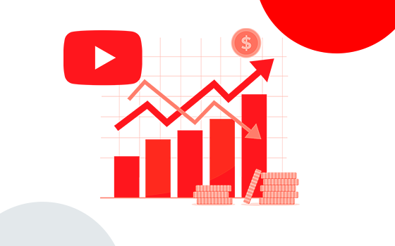
INTRODUCTION
In the evolving landscape of online content, YouTube stands as the main platform where videos crave attention and visibility.
Videos that tend to be popular achieve viral status, enabling them to be part of YouTube’s Trends page for more visibility and recognition.
Part of a full-time YouTube content creator’s job is to maximize potential visibility and views; hence they create strategies and content decisions.

Slide 3

Purpose of this Project
The main goal of this study is to explore and answer questions about the important metrics, strategies, and interactions with viewers that play a role in making a video go viral.
To Determine what certain genres are best to be involved in to get viral status while avoiding others
The motivation behind this is not just academic; it's an attempt to teach content creators with insights for a deeper understanding of the YouTube algorithm.

Slide 4

Dataset Overview
The dataset is available to download on Kaggle and has been updated daily ever since 2018, making it free for anyone to use.
The dataset used for this project showcases videos and their metadata that have achieved viral status and landed on the US Trends page of YouTube.
The dataset consists of 15 columns and 292’589 rows.

Slide 5

Metadata that Matters
The only columns that will be worked on during the course of the project are:
Views
Likes
Comment count
Tags
Title Names
Genres
Ratings (Enabled/Disabled)
Comments (Enabled/Disabled)

Slide 6

Tools Used for this project
Excel: For data collection and dataset creation.
Python: For data analysis, manipulation, and visualization, with a focus on the Jupyter Notebook web application.

Slide 7

Metrics that Matter
Views
Likes
Dislikes

Slide 8
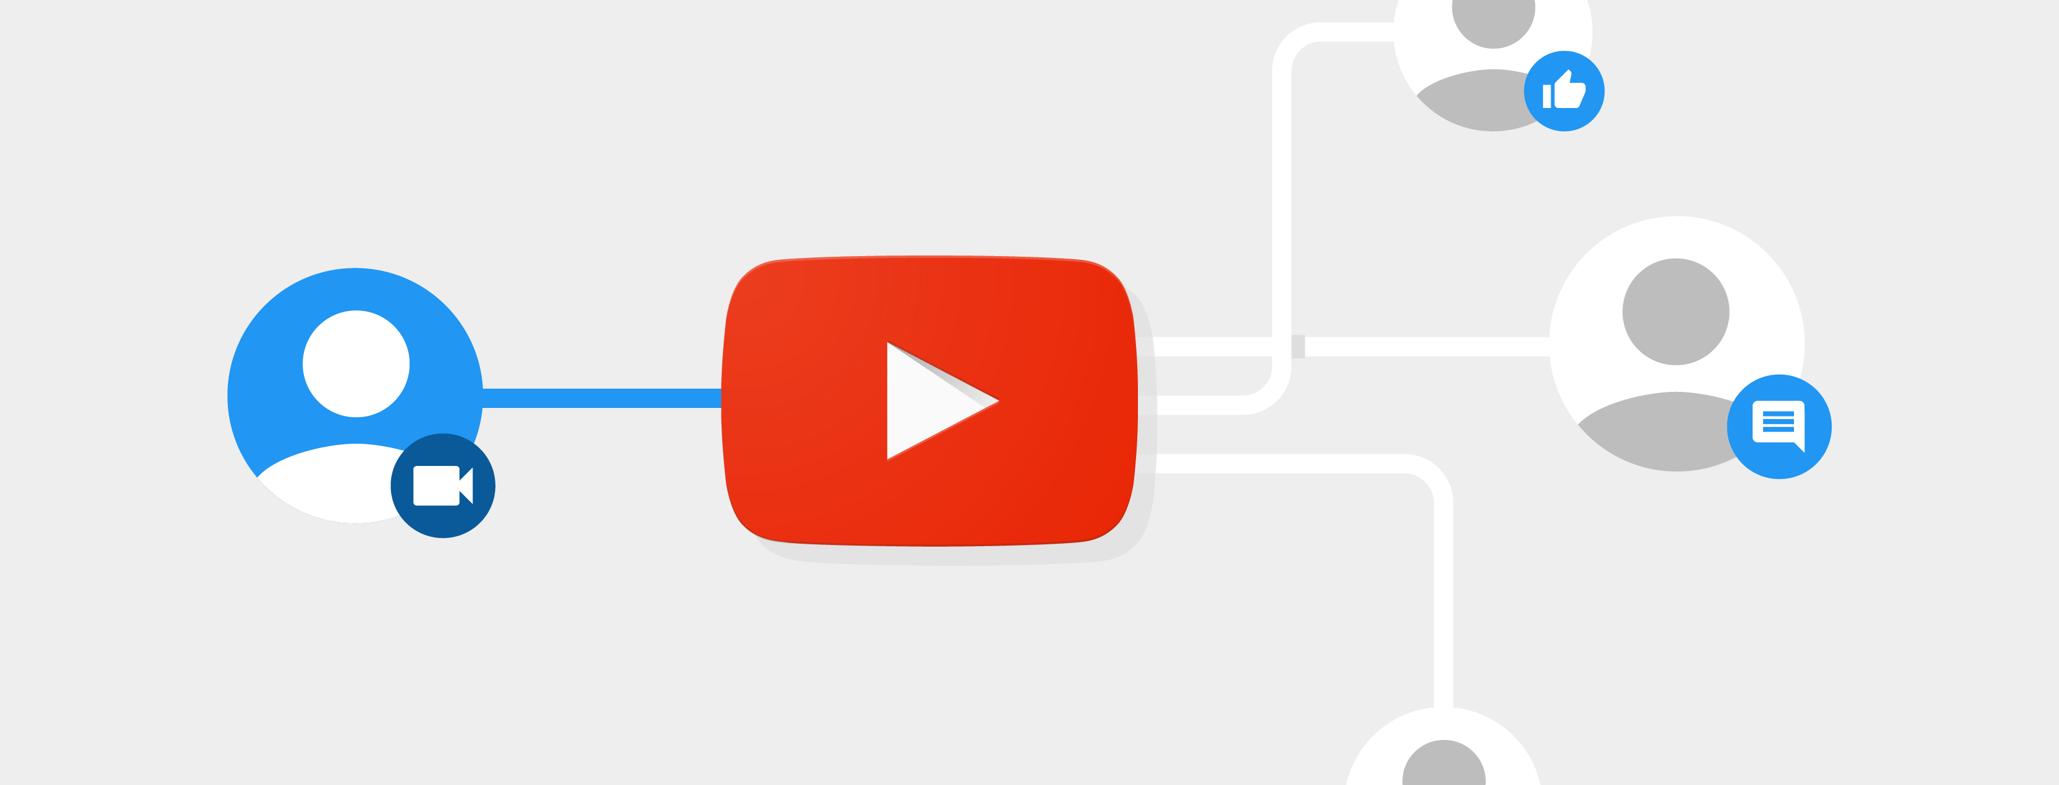
Metrics That Matter
 | view_count | likes | dislikes
view_count | 1.000000 | 0.845533 | 0.696190
Views represent the total watch time of a video and are crucial for gauging its success.
This project establishes the significance of likes and dislikes, showcasing their correlation with views, making them equally important indicators of a video's success.

Slide 9
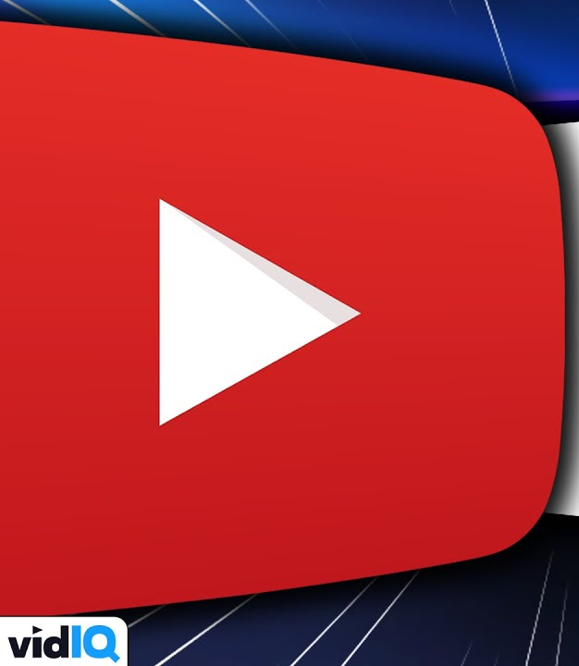
Tags Usage
Popular tags’ presence in videos
Correlations between popular tags and reactions

Slide 10
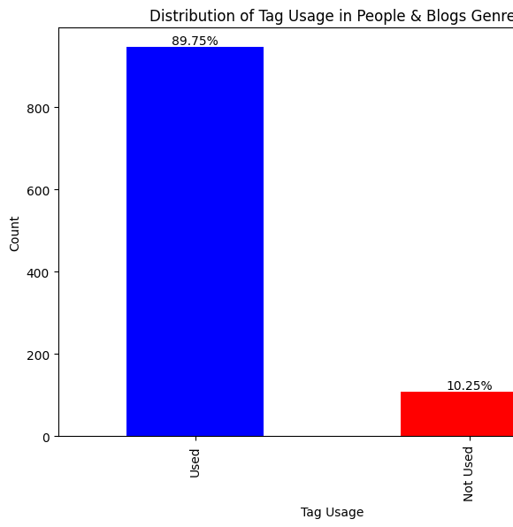
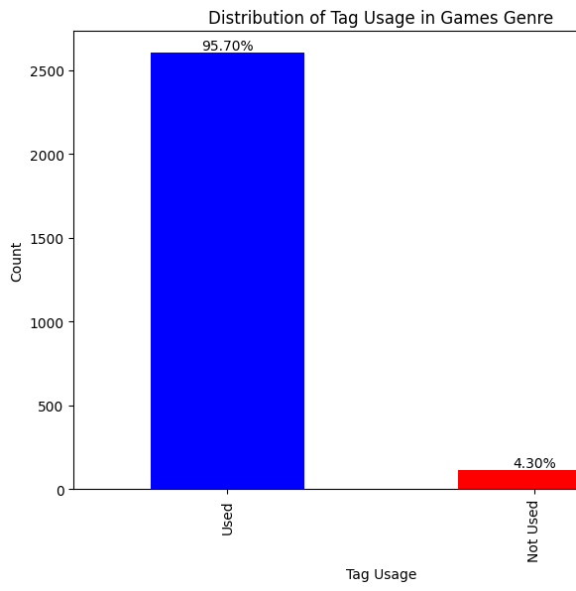
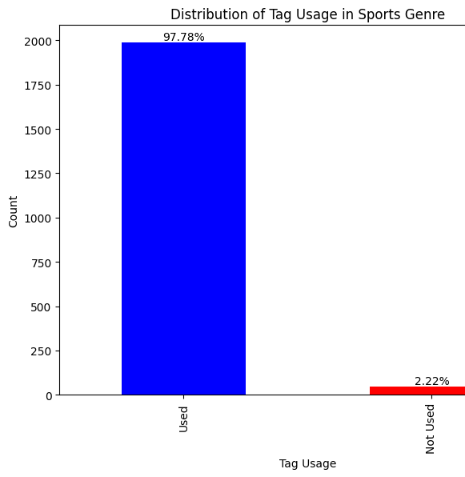
Popular Tags’ Presence in Videos
The dataset was divided into three genres(Sports, People & Blogs, Games), and the top 10% most frequently used tags were identified.
The analysis confirmed that these popular tags were consistently present in all videos across the three genres.

Slide 11
Correlations Between Tags and Reactions
The analysis involved counting the occurrences of the most popular 10% tags within the tag's sections of videos from the Sports, People & Blogs, Games genres . Subsequently, their frequencies were correlated with views, likes, and dislikes.
Despite their high presence, tags had no significant correlation with the reactions, indicating that their presence does not contribute to increasing a video's popularity.

Slide 12
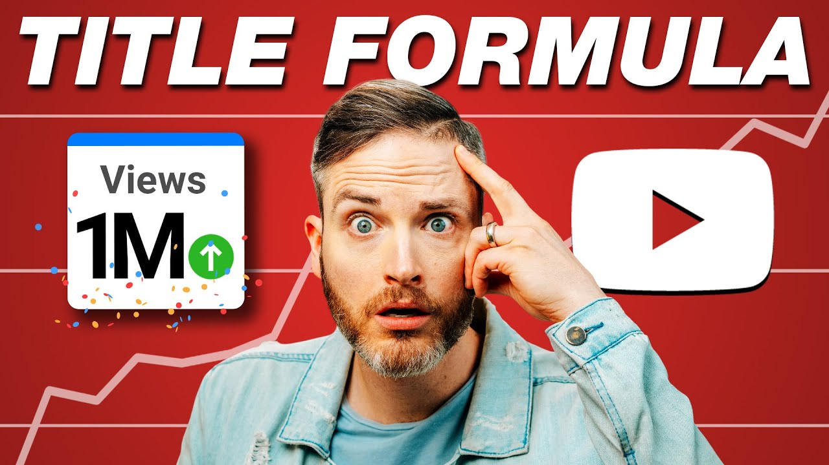
Video Title Analysis
Title Length Analysis
Title Word Analysis
Correlations Between Popular Title Words and Reactions

Slide 13
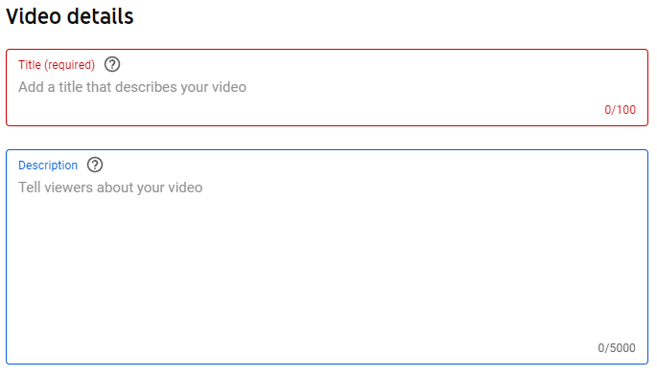
Title Length Analysis
Frequencies of words were counted for each individuel video title and the correlation was measured between each word frequency and views
Title length does not affect any reaction
Correlation between Title Length and View Count: -0.05

Slide 14

Popular Words’ Presence in Videos
In the Sports genre, the most popular 10% words of titles were identified
The analysis confirmed that these popular words were consistently present in all videos across the Sports genre.

Slide 15
Correlations Between Words and Reactions
The analysis involved counting the occurrences of the most popular 10% words within the title words sections of videos. Subsequently, their frequencies were correlated with views, likes, and dislikes.
Despite their high presence, words on titles had no significant correlation with the reactions, indicating that their presence does not contribute to increasing a video's popularity.
Correlation between 'top_10_percent_count' and 'view_count': -0.01
Correlation between 'top_10_percent_count' and 'likes': -0.20
Correlation between 'top_10_percent_count' and 'dislikes': -0.01

Slide 16
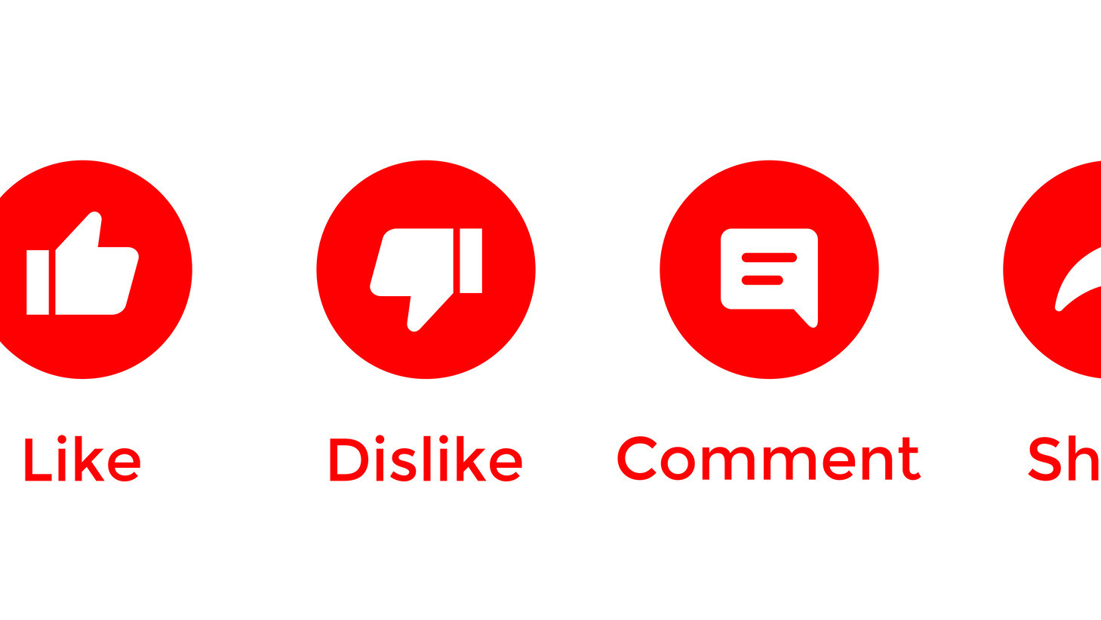
Settings for Success
Examine the importance of enabling/disabling comments and ratings.
Evaluate the consequences of different settings on viewer interaction and video reach.

Slide 17
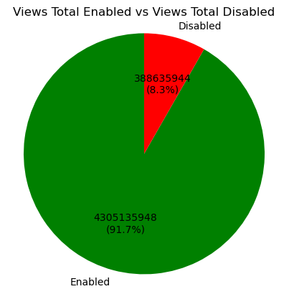
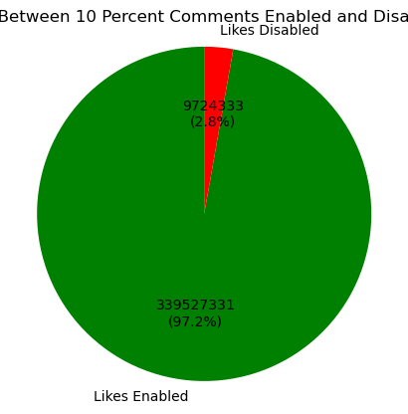
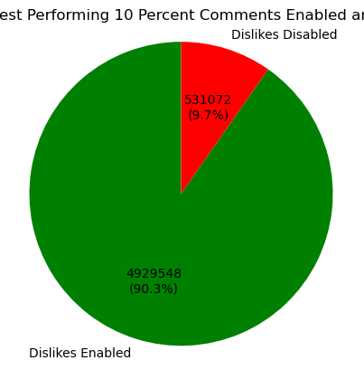
Videos with Comments Enabled/Disabled Comparison by Most Popularity
From the dataset, only 317 videos had comments disabled. The most popular 317 video were compared to the other 317 videos with comments disabled.
In these graphs, it is shown again that videos that have comments enabled tend to be more popular and more successful in the end.

Slide 18
Correlations Between Videos With Comments Enabled and Reactions
The analysis involved only including videos involving comments enabled and seeing the reactions and 10% most popular tite words and tags correlation.
Videos with comments enabled have a high enough correlation. However, like the previous analysis there are no correlations between tags and title words.
 | view_count | likes | dislikes | comment_count | comments_disabled | top_10_percent_count | top_10_percent_count_title
view_count | 1.000000 | 0.779049 | 0.581371 | 0.600531 | NaN | 0.079995 | 0.034690
likes | 0.779049 | 1.000000 | 0.505020 | 0.730848 | NaN | 0.060737 | -0.007781
comment_count | 0.600531 | 0.730848 | 0.409149 | 1.000000 | NaN | 0.017379 | -0.006674

Slide 19
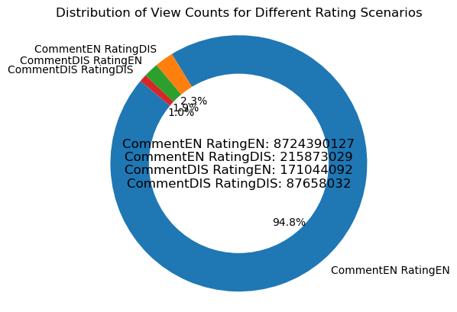
Success of a Video with Ratings/Comments Turned on Or Off
For this analysis, videos were comined to 4 categories: one with both comments and ratings enabled, one with only comments enabled and ratings disabled, another with comments disabled and ratings enabled, and the last one with both comments and ratings disabled. All their individuel views were accumulated and were compared with another.
The graph shows that videos with comments and ratings enabled are watched way more than the rest.

Slide 20

Genre Dynamics
Explore popularity dynamics across different video genres
Provide insights on genre selection based on popularity

Slide 21
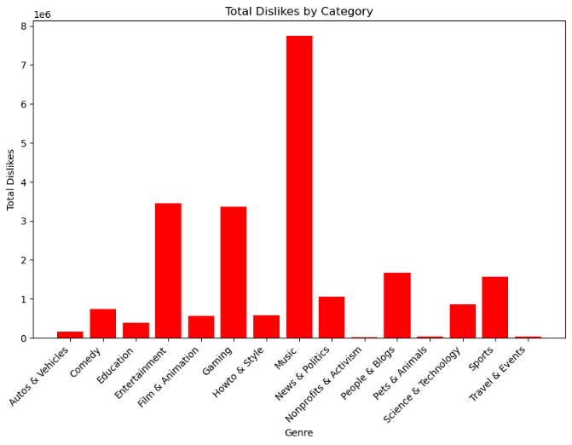
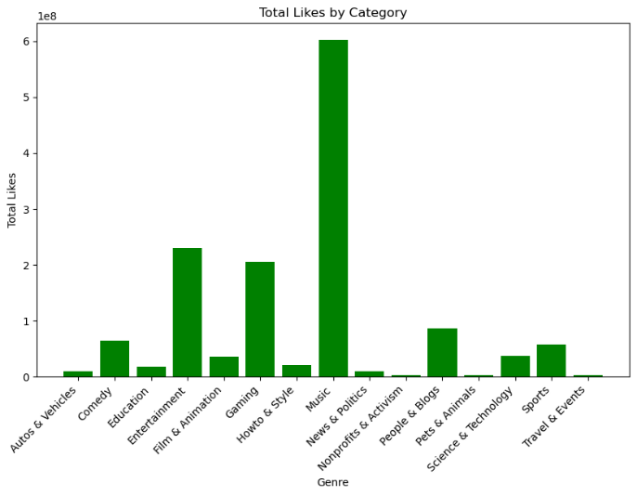
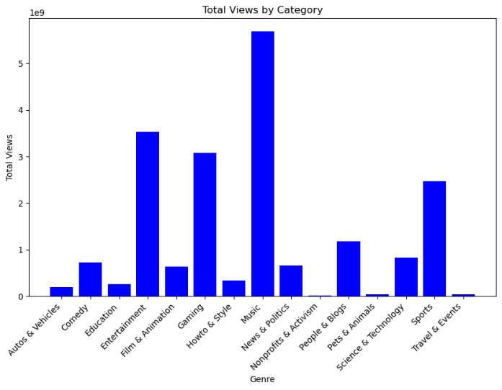
Determining the Most Popular Genres

Slide 22
Conclusion
Keeping likes and dislikes or reaction in general high wil guarentee more views and a viral status.
Specific tags on their own don’t grant more reaction and does not grant viral status on their own.
Specific title words on their own don’t grant more reaction and does not grant viral status on their own.
Content creators in all cases should enable ratings and comments.
While most genres are more popular than others, Non-practical & Activism, Pets & Animals and Travel & Events rarely get viral status and should be avoided to get it trending

Slide 23

Acknwoledgements
I want to thank Prof. Dr. Fatma Aydın Akgün for her continious support and guidence throughout this project and for her assistance in helping creating this thesis.

Slide 24
Contact Information
Rotinda Öner
rotindaoner@gmail.com
LinkedIn: https://www.linkedin.com/in/rotinda-%C3%B6ner/
GitHub: https://github.com/cRotinda
Mathematical Engineering Department
Yıldız Technical University

